Slide 1
KMeans

Slide 2
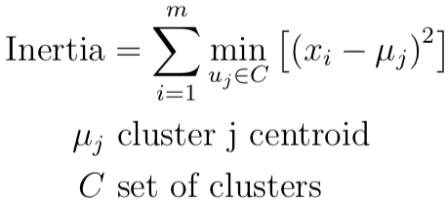
KMeans
Split data into clusters
Minimize squared distance from each point in cluster to cluster center (inertia)

Slide 3
Algorithm
Set number of desired clusters, k
Randomly set cluster centers (centroids)
Pick k instances from X randomly

Slide 4
Algorithm
Set number of desired clusters, k
Randomly set centroids
Group each sample into the nearest centroid
Find mean of each cluster and update centroid location for each cluster to that position
Repeat previous 2 steps until convergence (centroids move less than the tolerance)

Slide 5
Local Minima
Initialization methods
Initialize randomly several times and take solution with lowest inertia
KMeans++
Initialize centroids to be distant from each other
Prob.of choosing point for centroid depends on squared euclidean distance to existing centroids

Slide 6
Mini Batch KMeans
Rather than processing full dataset at each update iteration, process only a random subset at each update iteration
Random subset selected new at each new iteration

Slide 7
Mini Batch KMeans
Process only a random subset at each update iteration
1 iteration:
Select random subset
Assign to nearest centroid
Update centroid based on all current, and previous, datapoints assigned to it

Slide 8
Mini Batch KMeans
Process only a random subset at each update iteration
1 iteration:
Select random subset
Assign to nearest centroid
Update centroid based on all current, and previous, data points assigned to it
Speed vs performance (generally performance dips are not very large)

Slide 9
Considerations
High dimensions - dimensionality Reduction (e.g. PCA) into KMeans, since euclidean distances in high dimensions are not as useful
Implicit assumption about cluster assignment through distances from center, this doesn’t always hold true

